Slide 1
Lecture 5: CSS Deep Dive

Slide 2
Submit Homework
All your designs are turned in

Slide 3
CSS Deep Dive: This week overview
Working with InVision
Advanced CSS
Layouts
Positioning
Backgrounds
Rounded Corners
Shadows
Parent Child Selectors
Advanced Colors
Attribute Selectors
CSS Transitions
Backgrounds
Transforms
Gradients
Media Queries
Flexbox

Slide 4
Working with InVision

Slide 5
Prepare your design files
Open your files
Save each Canvas/Artboard
Save As “page-name”.[png, jpg, jpeg]
Ex. if I’m on the Homepage Artboard I would export my Artboard as “homepage.png”
Save your file to > project-name/exports
Ex. my project is Defones so I would save to deftones-site/exports
Make sure to also save your Overlay files too
An overlay file is for example a canvas that represents your Lightbox effect
Upload to inVision

Slide 6

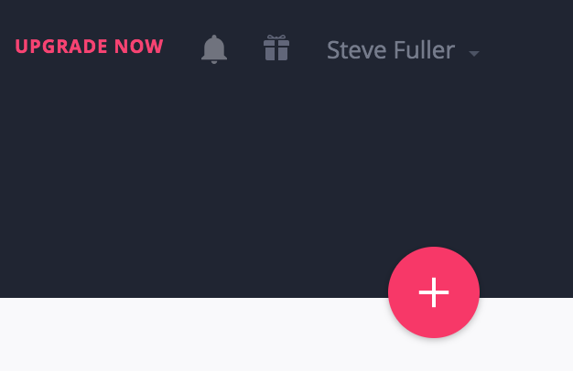
Sign Up for a Free inVision Account
Visit https://invisionapp.com
Sign up / Sign In
Click the big red button with a plus sign
Create New Prototype
Name of Project “Your Band” & Select “Desktop(Web)”
Upload your files
Drag and drop all your files in your Export folder
Optional arrange files
I like to arrange my files by my navigation order
Create prototype

Slide 7
How to create actions
Make sure to review inVisions Help Center for how tos
Main Links
Building Projects
Adding Interactivity
Articles of concern
Creating a Prototype
Upload Screens
Syncing Screens
Adding Interactivity
Prototype Screens
Replacing Screens

Slide 8
Minimum Requirements
All pages must be linked
Demonstrate Lightbox Effect
Demonstrate Filter Effect

Slide 9
CSS Deep Dive: Last Week Review
What is CSS
“History” of CSS
Revist developer tools
First External CSS file
Basic CSS:
Colors
Fonts
Typography
Selectors
Box Model
Shorthand

Slide 10
CSS Deep Dive: Questions over reading
CH 12
Mobile Stylesheets
CH 14
Vendor prefixes
Browser Compatibility
Rounded corners
etc.

Slide 11
Advanced CSS

Slide 12
CSS: Inheritance
Inheritance and the cascade are two fundamental concepts in CSS.
Inheritance is associated with how the elements in the HTML markup inherit properties from their parent elements and pass them on to their children
The cascade relates to CSS declarations being applied to a document, and how conflicting rules do or do not override each other
This is important because it keeps your code DRY (Don’t Repeat Yourself) by cutting down on redundant code.

Slide 13
CSS: Inheritance Example

Slide 14
CSS: Block Elements
Inline Elements
Respect Left & Right margins and padding but not top & bottom
Cannot have a width and height set
Allow other elements to sit to their left and right
Block Elements
Respect all
Force a line break after the block element
Inline-block Elements
Allow other elements to sit to their left and right
Respect top & bottom margins and padding
Respect height and width
Background: the difference between div and span
W3schools Block-level Elements

Slide 15
CSS: Block Example

Slide 16
CSS: Pseudo Classes
Defines a special state of an element
Style an element when you perform an action
selector: pseudo-class { property: value; }
MDN web docs Pseudo-classes

Slide 17
Pseudo Class Examples

Slide 18
CSS: Specificity
Overriding styles can be done in a couple of ways
When overriding styles things can become confusing very quickly so do this with caution

Slide 19
CSS Deep Dive: Advanced CSS
Rounded Corners
Shadows
Box Shadow Generator
Parent Child Selectors “Combinators”
Transparency
Colors
Images
CSS Transitions

Slide 20
CSS: Specificity
“Apart from Floats, the CSS Specificity is one of the most difficult concepts to grasp in Cascading Stylesheets” - Smashing Magazine
Determine which CSS rule is applied by the browser
Every selector has place in specificity hierarchy
5 Categories of specificity
Inline Styles
IDs
Classes
Attributes
Elements

Slide 21
CSS: Specificity examples

Slide 22
CSS DD: Advanced CSS contd.
Backgrounds
Perfect background image
Transforms
Gradients
Gradients
Gradient Generator
Media Queries
@ Rule
Responsive Web Design
Flexbox
About
CSS Tricks Complete Guide

Slide 23
That’s it

Slide 24
Week 5: Homework
Build InVision prototype with final designs
Read Chapter 15
Practice Coding
Advanced CSS topics
Try installing and using Twitter Bootstrap
Research responsive tutorials and practice

